Slide 1

Market Equilibrium
1.1.3 Demand, Supply and
Market Equilibrium

Slide 2

Learning objectives
Equilibrium price and quantity and how they are determined.
The use of diagrams to show:
  how shifts in supply and demand affect equilibrium price and quantity in real-world situations
  excess demand
  excess supply.
Define, calculate and draw excess demand and excess supply.
The use of market forces to remove excess supply or excess demand.
Today you will learn…

Slide 3
Recap - demand
Which are true about the demand curve?:
When the price falls, the quantity demanded falls.
There is a proportionate relationship between price and the quantity demanded?
It slopes from left to right.
When there is a price change, there is a movement along the demand curve.
Cars and petrols are examples of which goods?
Inferior goods
Complementary goods
Substitute goods
Capital goods
A rise in the price of car insurance may have which effect?
Increase the quantity demanded for cars
Increase the quantity demanded for car insurance
Shift the demand curve for cars to the left
Shift the demand curve for the cars to the right

Slide 4
Recap - supply
Which of the following is true about supply?
If price increases the supply curve will shift to the right.
If the price falls, the quantity supplied will also fall.
The amount supplied and the price are inversely related?
The supply curve is always horizontal
Which of the following will shift a supply curve to the left?
A decrease in indirect taxes
Higher production costs
The introduction of new technology in production.
A government subsidy
A bumper wheat harvest across the world resulting from favourable weather conditions will do what?
Shift the supply curve for wheat to the right.
Reduce the quantity demanded for bread
Increase the price of wheat
Reduce the price of butter

Slide 5
Demand AND Supply
Draw one graph with both demand and supply.
What is the name of the point where the two curves cross?
Equilibrium - what does equilibrium mean?
Stand up equilibrium
Notes:
All students pick 2 other students in the class. They must be an approximately equal distance between each of them.

Slide 6
The market equilibrium
The market equilibrium is where demand equals supply.
At this point, buyers and sellers are happy to sell at the price of the equilibrium point - Pe.
At this price, there is only so many consumers that are willing and able to buy the product (demand) and only so many producers that are willing and able to sell the product (supply). The amount is Qe.
But how do we know what the equilibrium price is in real life?? For example, how do we know that the price for carbonated soft drinks is around HKD8?
S
Pe
Market equilibrium
D
Qe

Slide 7
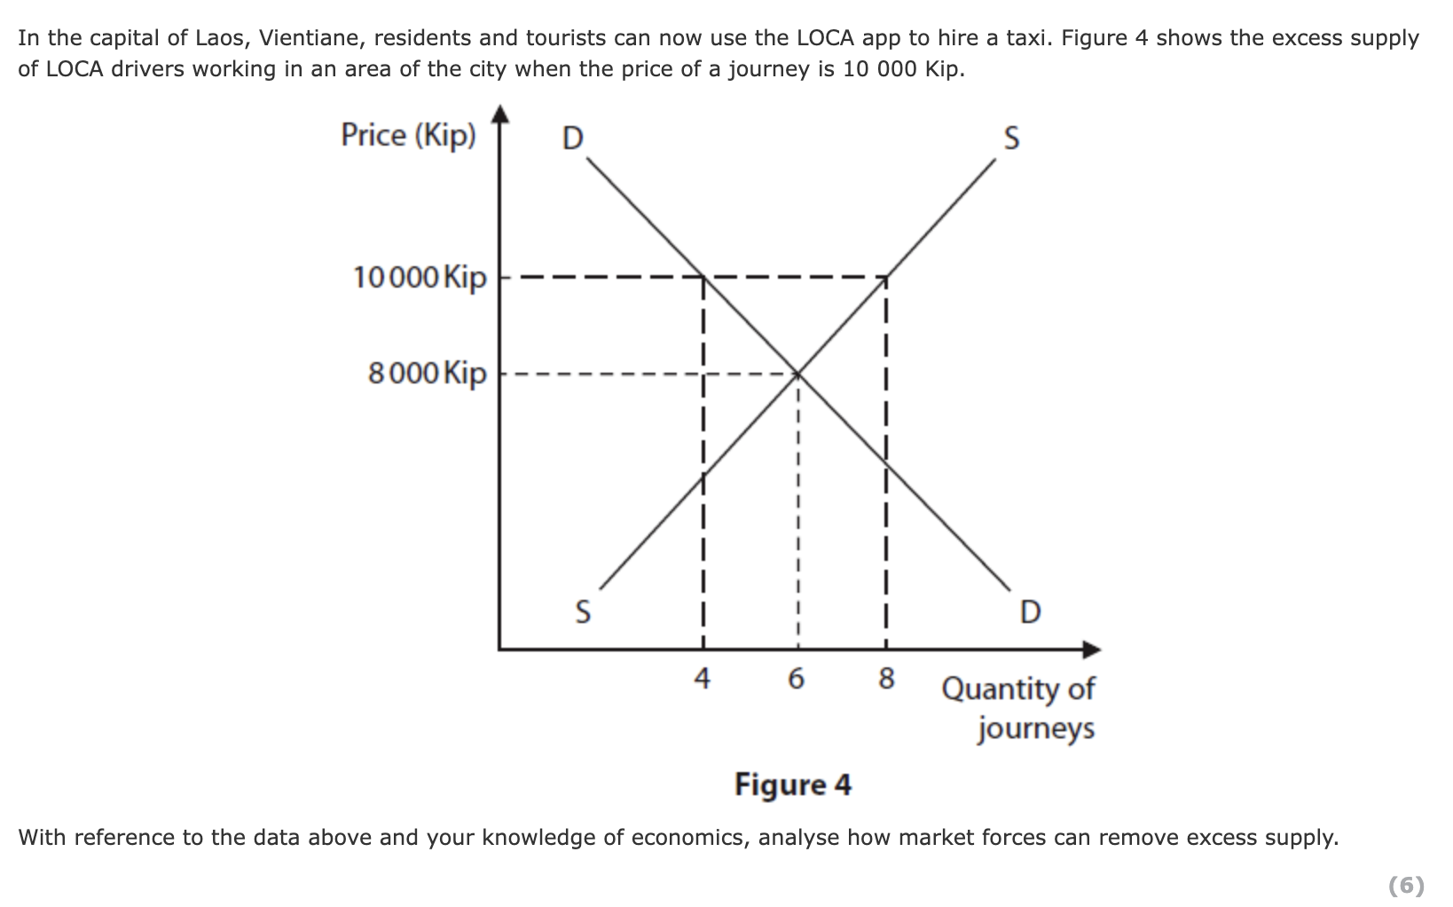

Slide 8
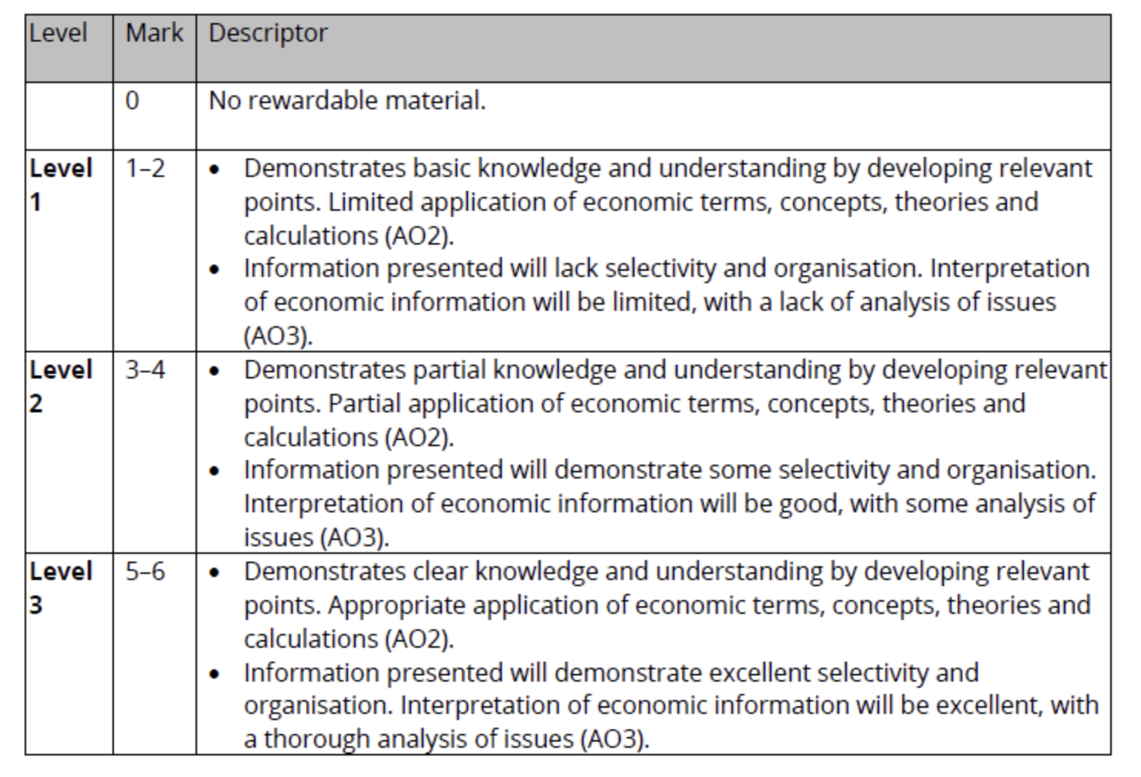

Slide 9
How does a market settle at market equilibrium?
Market equilibrium run through
Quiz

Slide 10
Practice
Using the information on these slides, draw diagrams to illustrate what happens to the market following the changes on slides 6 and 7.

Slide 11
Notes:
Criss cross activity

